Slide 1
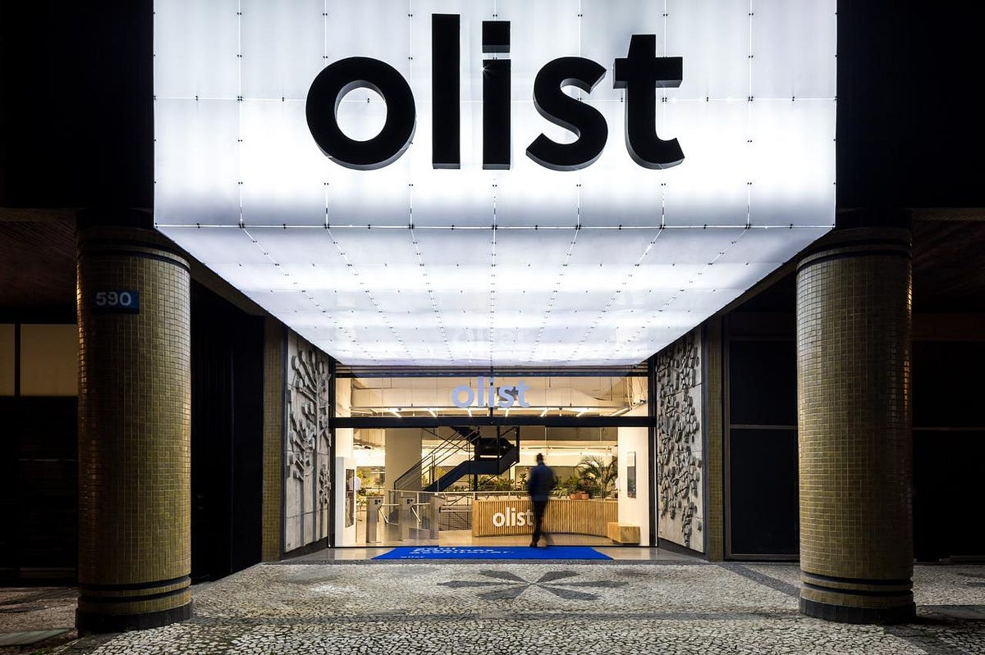

OLIST STORE DATA ANALYSIS
P-390 Project -> Group 6
Project members :
Ms. Tanuja Topare
Ms. Ashwini Rathod
Ms. Ayesha jasrotia
Mr. Siddhant divekar
Mrs. Pooja Jadhav
Mr.rupesh gorge
Project members :
Ms. Tanuja Topare
Ms. Ashwini Rathod
Ms. Ayesha jasrotia
Mr. Siddhant divekar
Mrs. Pooja Jadhav
Mr.rupesh gorge

Slide 2


ABOUT OLIST STORES
Olist data is a Brazilian E-Commerce Public Dataset.
The dataset has information of 100k orders from 2016 to 2018 made at multiple marketplaces in Brazil.
This is real commercial data, it has been anonymized.
Olist is the largest department store in Brazilian marketplaces. Olist connects small businesses from all over Brazil to channels without hassle and with a single contract. Those merchants are able to sell their products through the Olist Store and ship them directly to the customers using Olist logistics partners. The company emphasizes the structuring of the product and focuses on service excellence for the tenants and the end consumers.

Slide 3
Dataset Description
olist_orders_dataset: This table is connected to 4 other tables. It is used to connect all the details related to an order.
olist_order_items_dataset: It contains the details of an item that had been purchased such as shipping date, price and so on.
olist_order_reviews_dataset: It contains details related to any reviews posted by the customer on a particular product that he had purchased.
olist_products_dataset: It contains related to a product such as the ID, category name and measurements.
olist_order_payments_dataset: The information contained in this table is related to the payment details associated with a particular order.
olist_customers_dataset: Details the customer base information of this firm.
olist_geolocation_dataset: It contains geographical information related to both the sellers and customers.
olist_sellers_dataset: This table contains the information related to all the sellers who have registered with this firm.

Slide 4




DATA SCHEMA
The data is divided in multiple datasets for better understanding and organization.

Slide 5
KPI ANALYSIS TO BE FOUND
Weekday Vs Weekend Payment Statistics.
Number of Orders with review score 5 and payment type as credit card.
Average number of days taken for pet-shop.
Average price and payment values from customers of Sao Paulo city.
Relationship between shipping days Vs review scores.

Slide 6
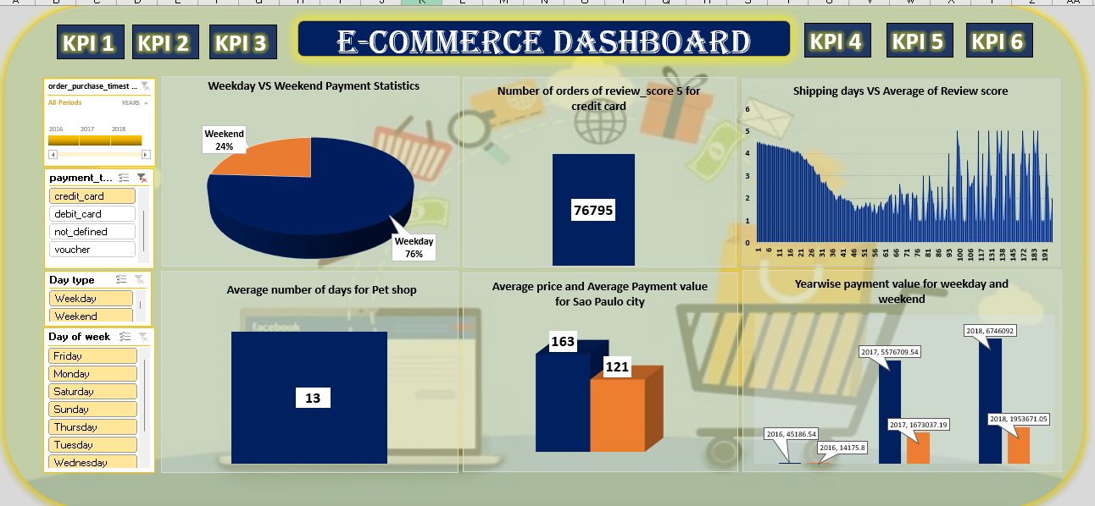
Excel Dashboard

Slide 7
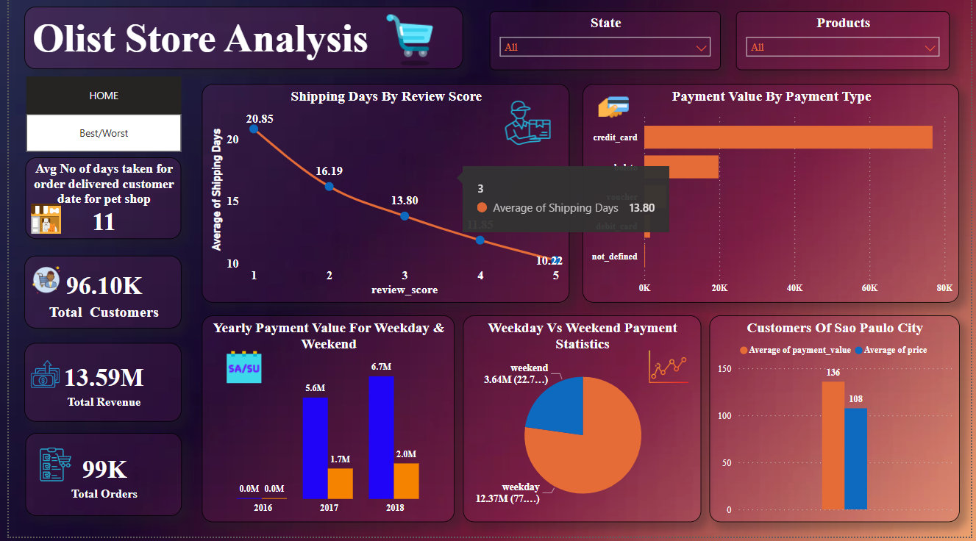
Power BI Dashboard

Slide 8
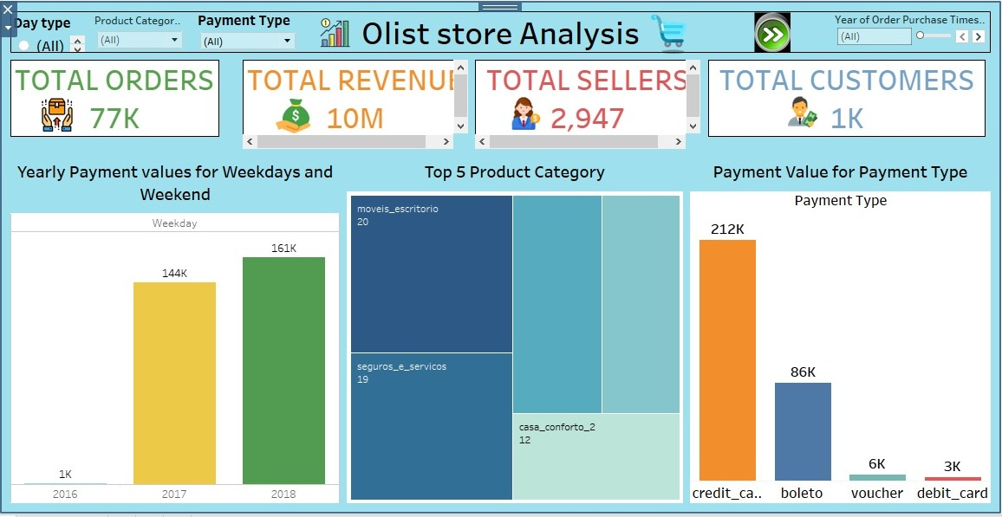
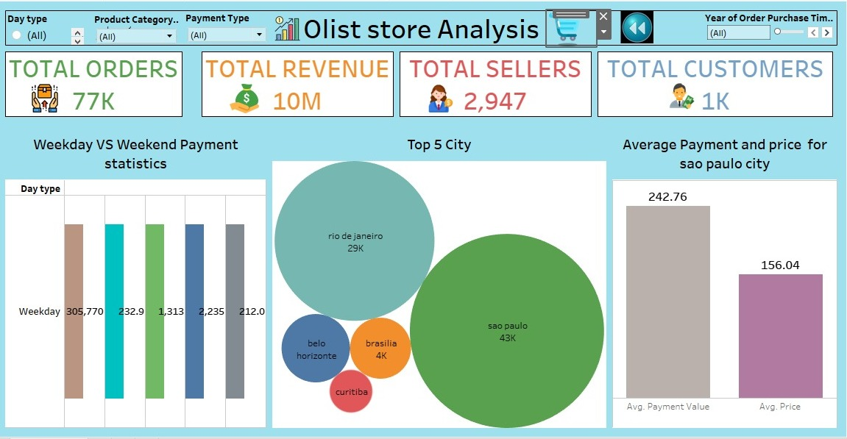
Tableau Dashboard

Slide 9
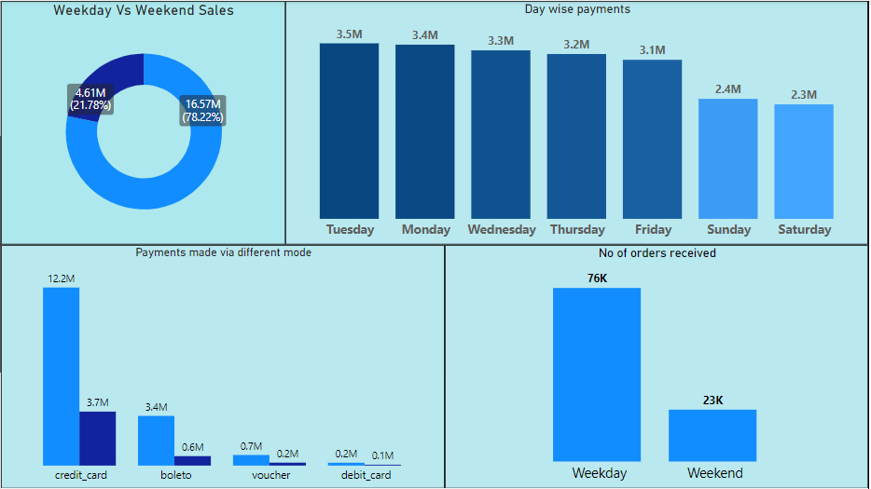
KPI_1 → Weekday Vs Weekend Payment Statistics
Weekday sales – 79 %
Weekend sales – 22 %
Analysis:
Most of the sales are done on weekdays. Major sales happened on Tuesdays and on the weekend it’s on Sundays.
The highest number of payments are made through Credit card mode.
The number of orders received on weekdays is 76k and on weekends 23k.
Suggestion:
To increase the weekend sales we can release any special offers on the weekends or Tuesdays. Which helps to generate more revenue.

Slide 10
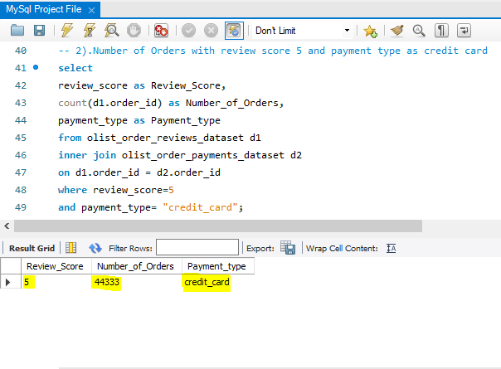
KPI_2 → Number of Orders with review score 5 and payment type as credit card
With a review score of 5 and payment type as a credit card, We received 44333 orders.
Overview:
- More orders have been placed via credit card payment than boleto, voucher, and debit card.
- More than 70% of sales were paid by Credit Card which is the main payment method in the market. However, payment using Boleto has slightly increased by 7% and a significant increase in using a debit card has been founded.
Suggestion:
If we want to increase sales, we can have a certain amount of discounts or no-cost EMI’s on card payments.

Slide 11
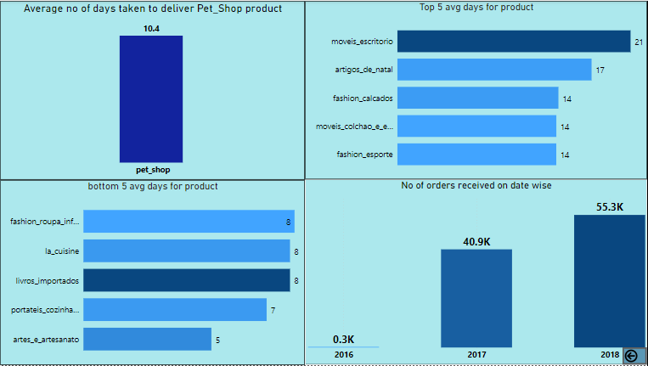
KPI_3 →Average number of days taken to deliver order for pet_shop
11 days is the avg days taken to deliver the order for pet shop.
Overview:
- 21 days is the maximum avg days taken to deliver the order and for the product : (Office furniture).
- 5 days is the minimum avg days taken to deliver the order and for the product: artes_e_artesanato (arts and craftmanship).
- Year wise sales are increasing which means we doing good in the market.
Suggestion:
We can work on faster delivery of the product moveis_escritorio by taking additional delivery measures.

Slide 12
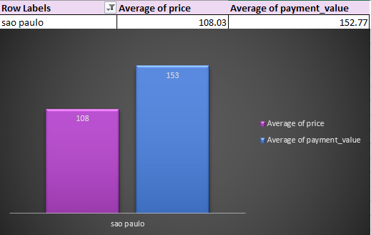
KPI_4 → Average price and payment values from customers of sao paulo city
Sao Paulo City – Avg price is 108 and avg payment is 153
Overview :
- The total number of customers is nearly 100K. We found out that São Paulo (SP) contains the most customers and is 3 times more than the second one. It is expected São Paulo has, particularly the most order payment value. Either Rio de Janerio (RJ) or Minas Gerais (MG) takes 10% of total customers. This indicates that the top 5 states contribute 80% of total customers.
Suggestion:
To increase sales on other cities we can work on faster delivery and easy payment modes and product wise offers.

Slide 13
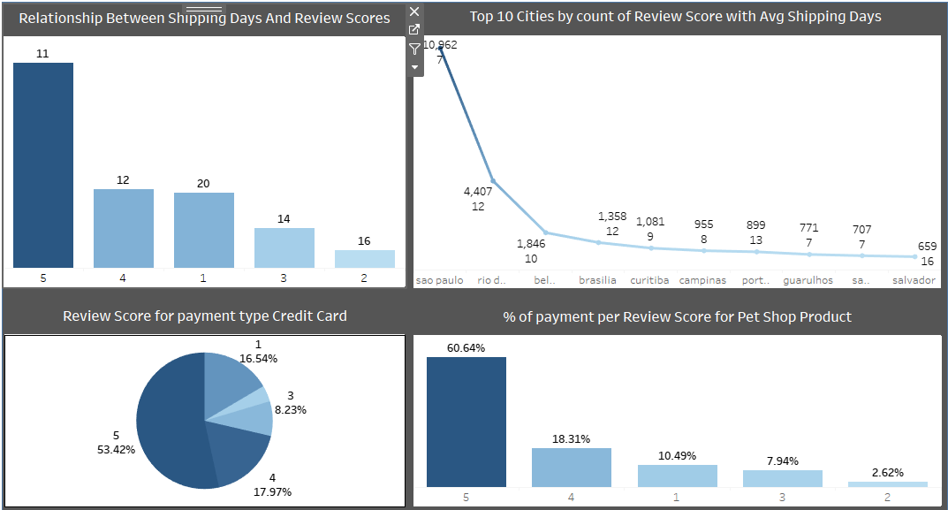
KPI_5 → Relationship between shipping days Vs review scores.
11 avg shipping days taken for review score 5 & 20 avg shipping days taken for review score 1.
Overview:
We get positive/high ratings when delivery time is less and negative feedback from the customers when it takes long to deliver the product.
Lesser the delivery days – the higher the positive reviews.
After analysing the review scores(customer satisfaction rating), the average score is 4.07/5, which shows positive satisfaction with Olist’s services.
Suggestion:
Minimizing the shipping days would lead to more positive reviews. Consecutively customer satisfaction will be met which leads to more business.

Slide 14
CONCLUSION
The analysis also focuses on the product categories with respect to the price and the review score of the customer. So, if the company focuses on the product’s pricing strategy and makes product improvements on the basis of consumer opinion, the company can make better revenue and can increase the range of products under each category.
The organization needs to purposely address the purchaser's survey and continue to adjust and change the item range. Future work in this space might incorporate recognizing how connections revealed in this investigation might be applied to further develop income inside comparative internet business organizations in Brazil

Slide 15
RECOMMENDATION
Olist should focus on those categories with more than average delivery time and shorten the delivery time to compete with other e-commerce platforms such as mercadolivre.com.br, olx.com.br, and americanas.com.br.
For the long delivery days product categories, security & services(seguros) and furniture(movies) could target the delivery days from more than 15 days to 13 days. Target computers(pcs), party-related suppliers(artigos), and console games(consoles) delivery days from around 14 days to 12 days. If not, 15% of customers may switch to other platforms. Customers are the core part of e-commerce.
The customers’ review score is limited to the score but lacks different aspects of the review. It is difficult to identify the score based on which part of the service, it could be the product, delivery arrangement, product quality, etc. Olist should set the review score survey based on the product’s pricing, quality, delivery arrangement, and customer service aspects. It would help to build a comprehensive score review.

Slide 16


